Slide 1
2020-06-02 Presentation
Salih Fırat Canpolat

Slide 2
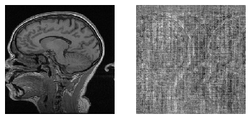
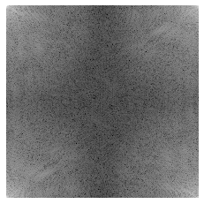
The Dataset
Single channel data from Multi-channel MR Image Reconstruction Challenge (MC-MRRec) is used.
25 training, 10 validation cases with 170, 256, 256, 2 shape (sampe, hy, hx, complex)
Magnitude
Phase
K-Space

Slide 3
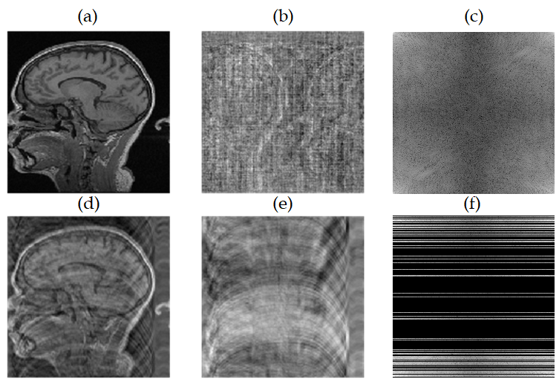
Undersampling
Cartesian sampling with 1 sample on center, 4 times acceleration, with no centering was used, 10 lines at the borders were used.
Data loader fed the model with the mask uniquely generated for each sample and each epoch.
Undersampling was done within the model except for magnitude input.

Slide 4
Models
Image Domain (ID) Magnitude Input
ID Single Dumbell
ID Two Dumbell
ID Dumbell with Consistency
ID Dumbell with 2x Consistency
K-Space (K) Image (I) K-Space(K)
K KI
K KIKI
Final Result ID Dumbell with 3x Consistency

Slide 5
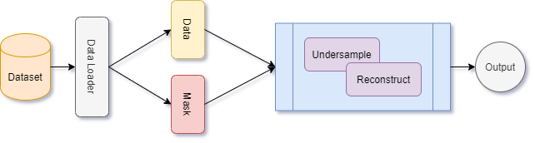
Reconstruction Operation Overview

Slide 6
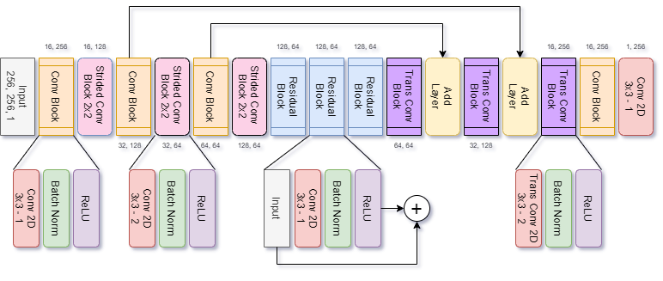
Base Model (Dumbell) Architecture

Slide 7
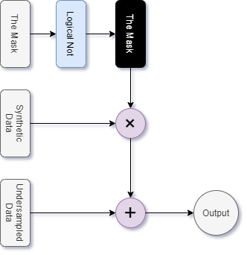
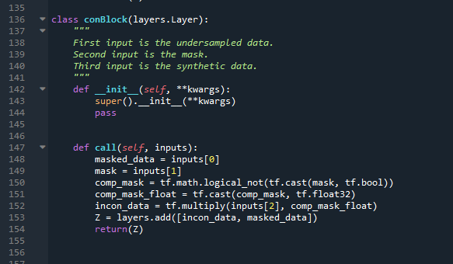
Consistency Block

Slide 8
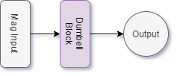
Image Domain – Magnitude Input

Slide 9
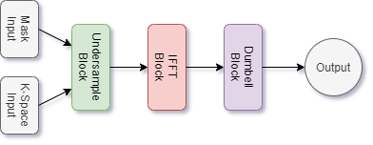
Image Domain without Consistency

Slide 10
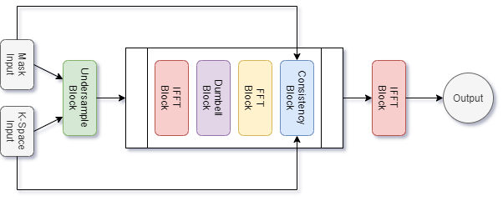
Image Domain with Consistency

Slide 11
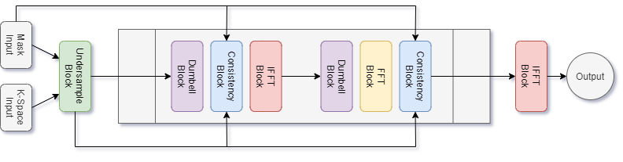
K-Space Consistency

Slide 12
Common Model Parameters
Optimizer: Adam
Learning Rate: 1e-3
Training: 15 epochs

Slide 13
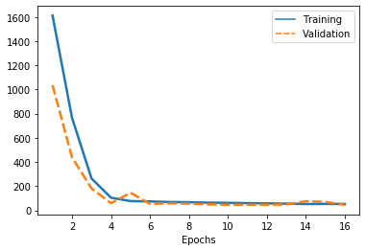
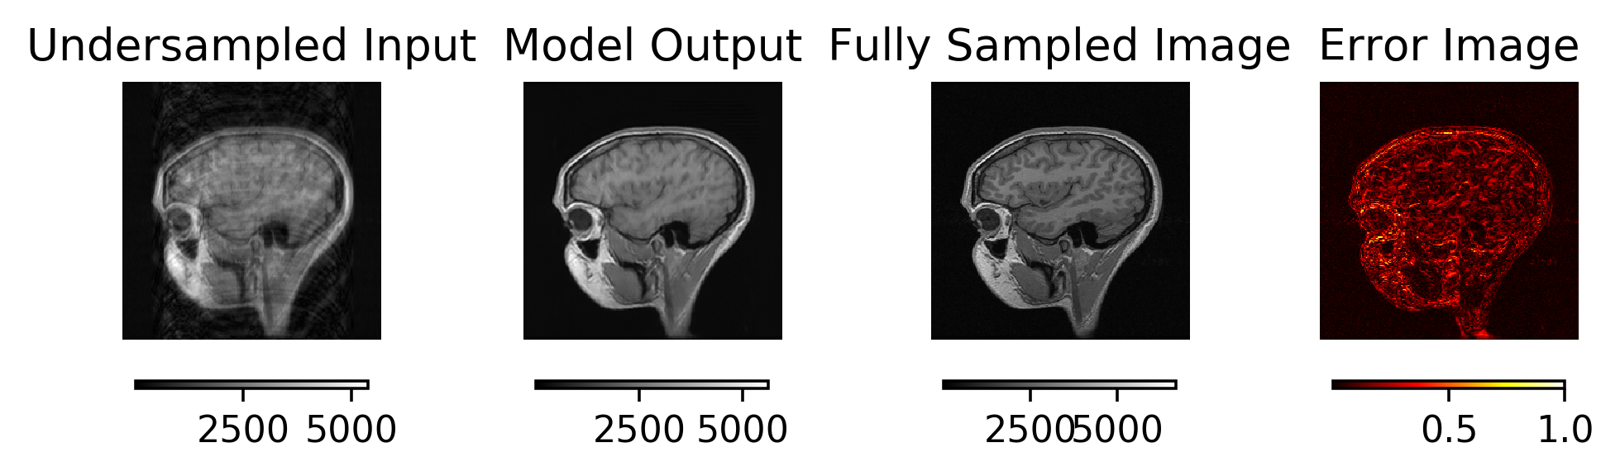
ID Magnitude Input

Slide 14
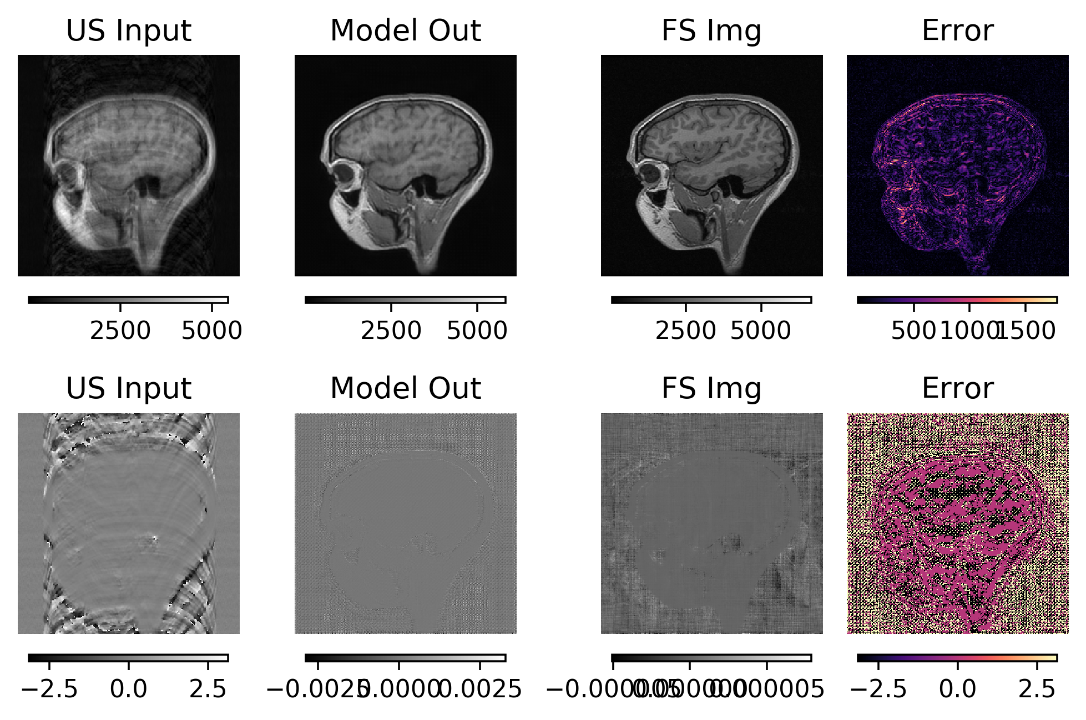
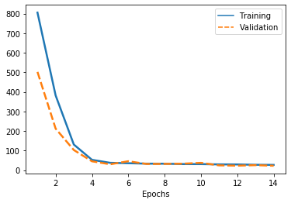
ID Single Dumbell

Slide 15
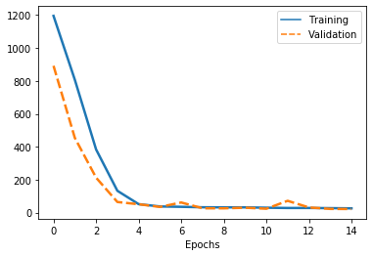
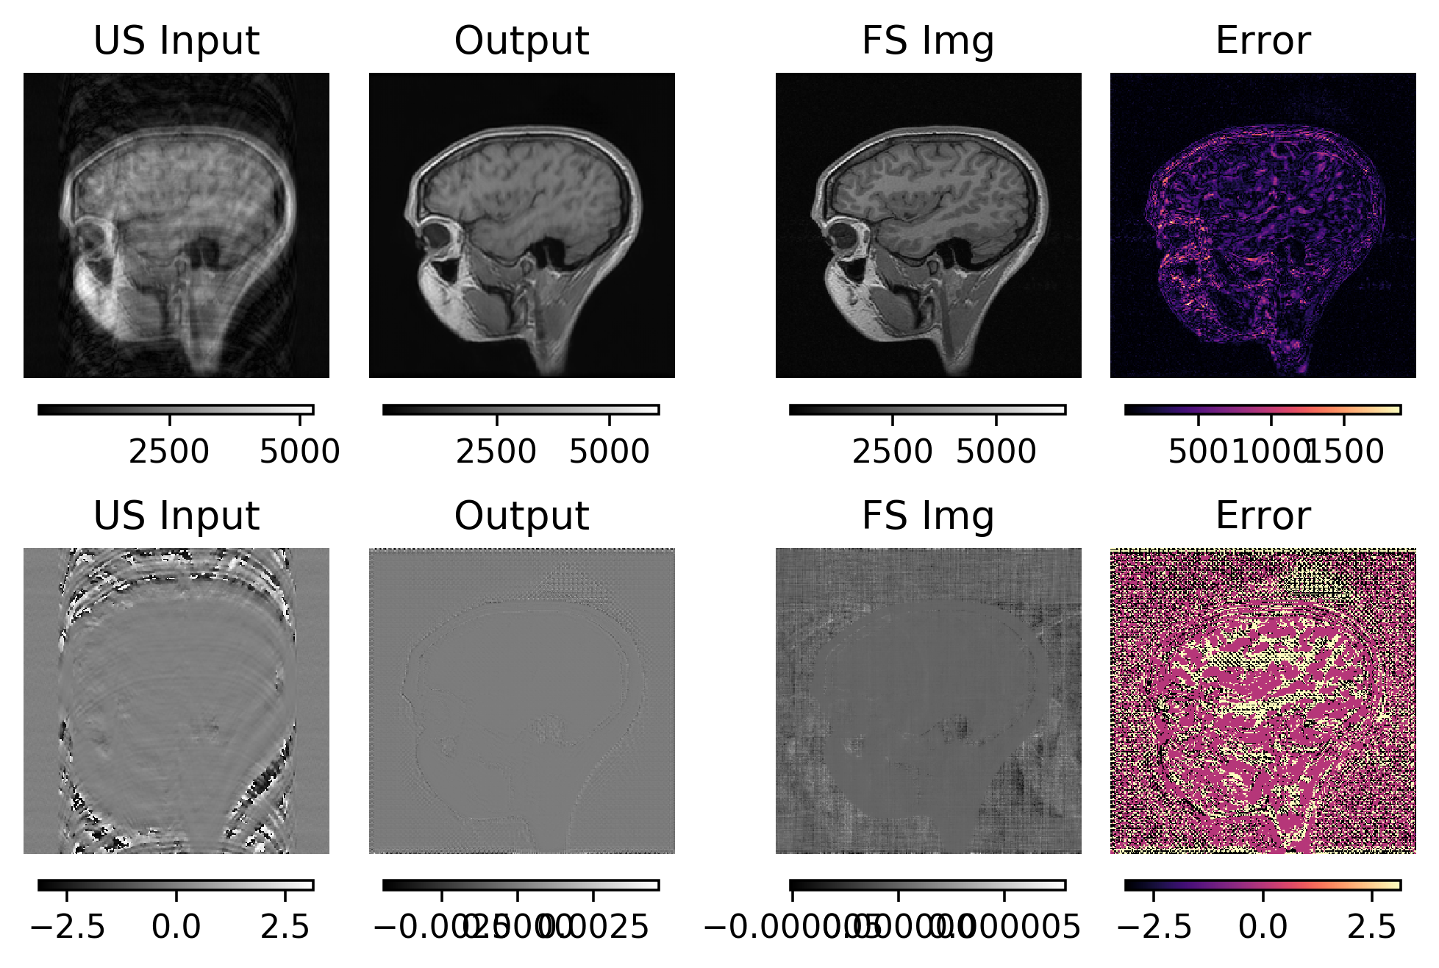
ID Two Dumbell

Slide 16
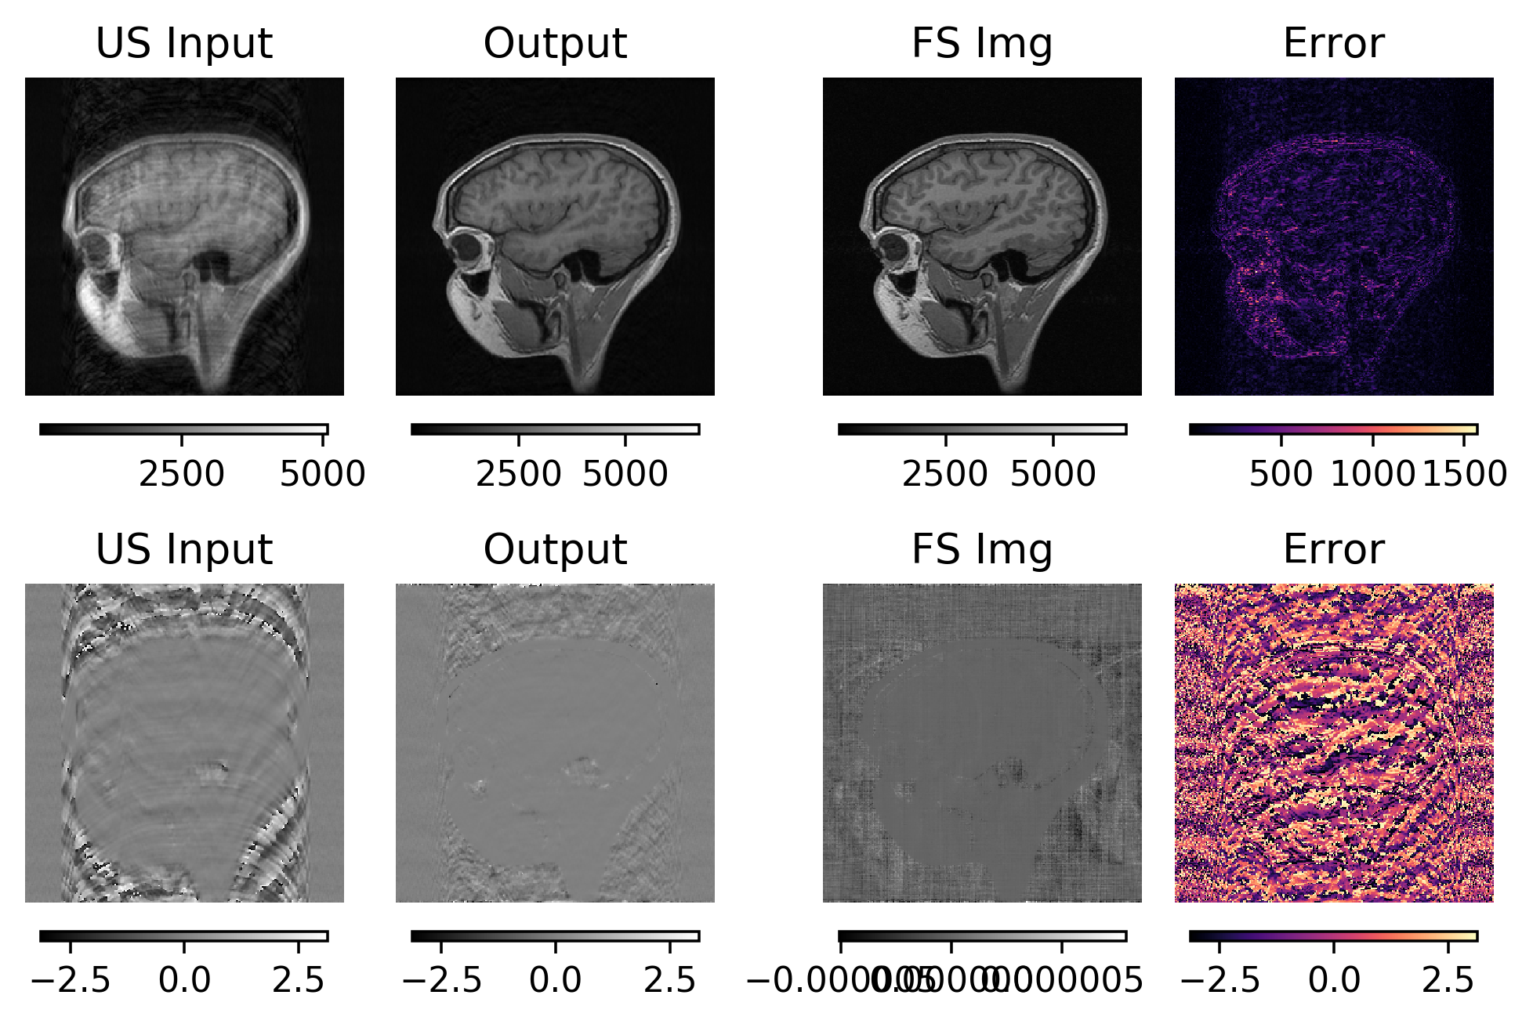
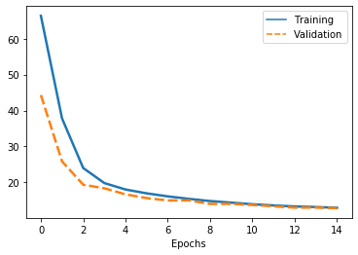
ID Dumbell with Consistency

Slide 17
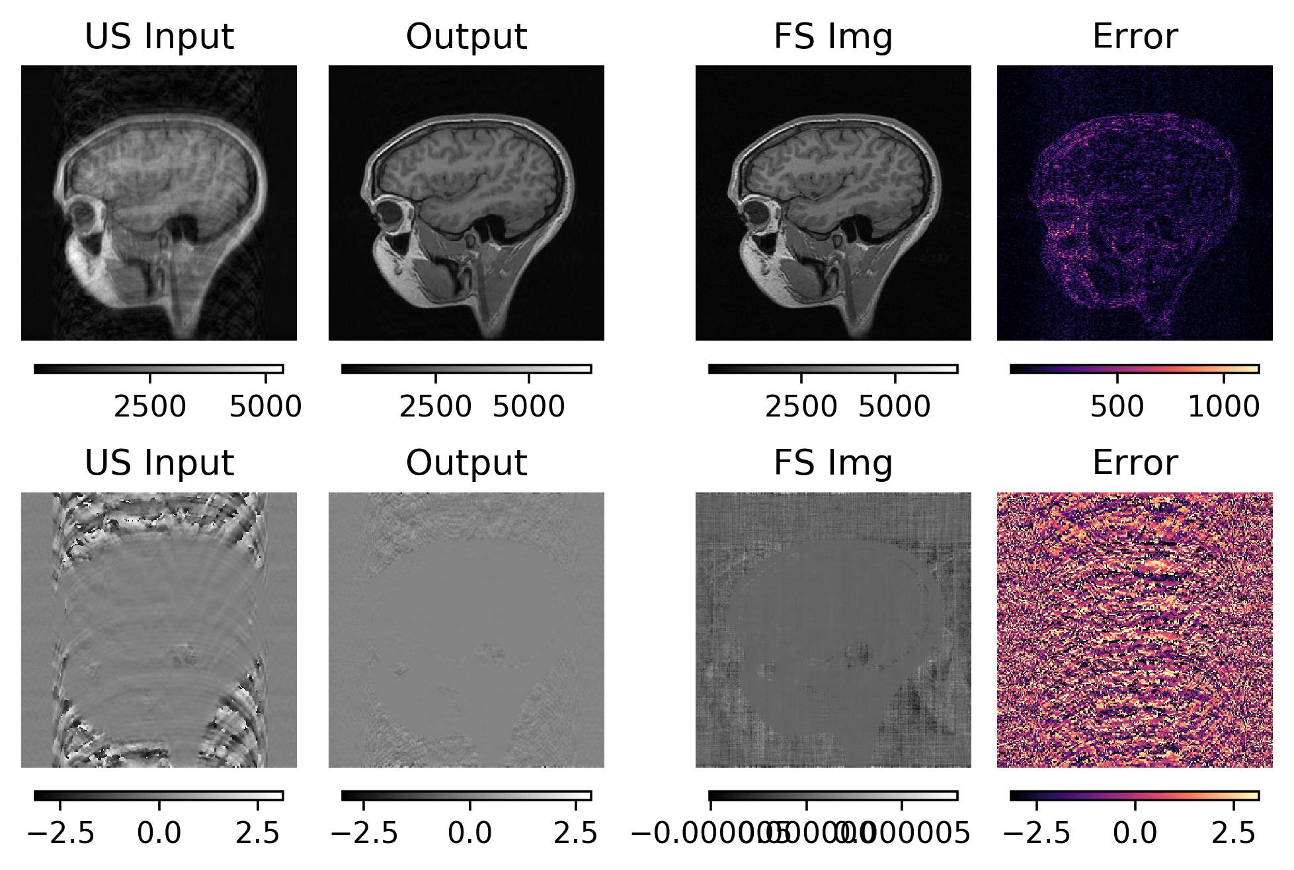
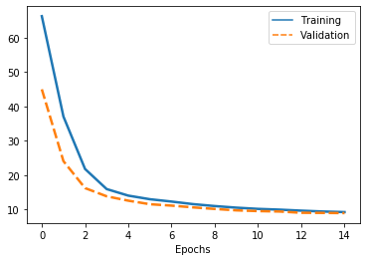
ID Dumbell with 2x Consistency

Slide 18
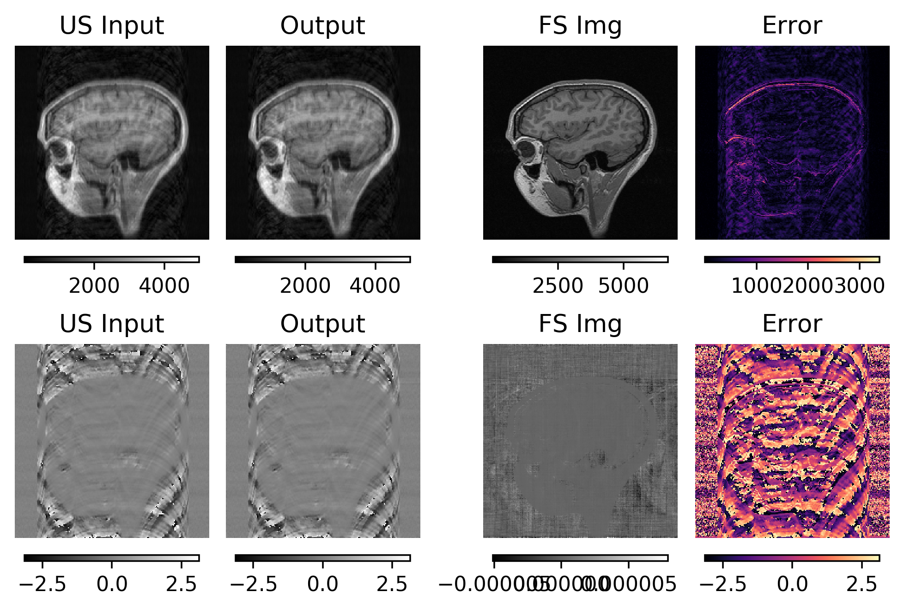
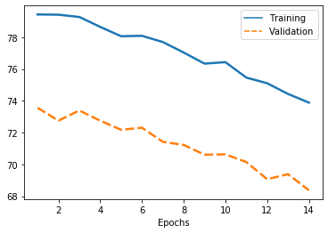
K-Space IK

Slide 19
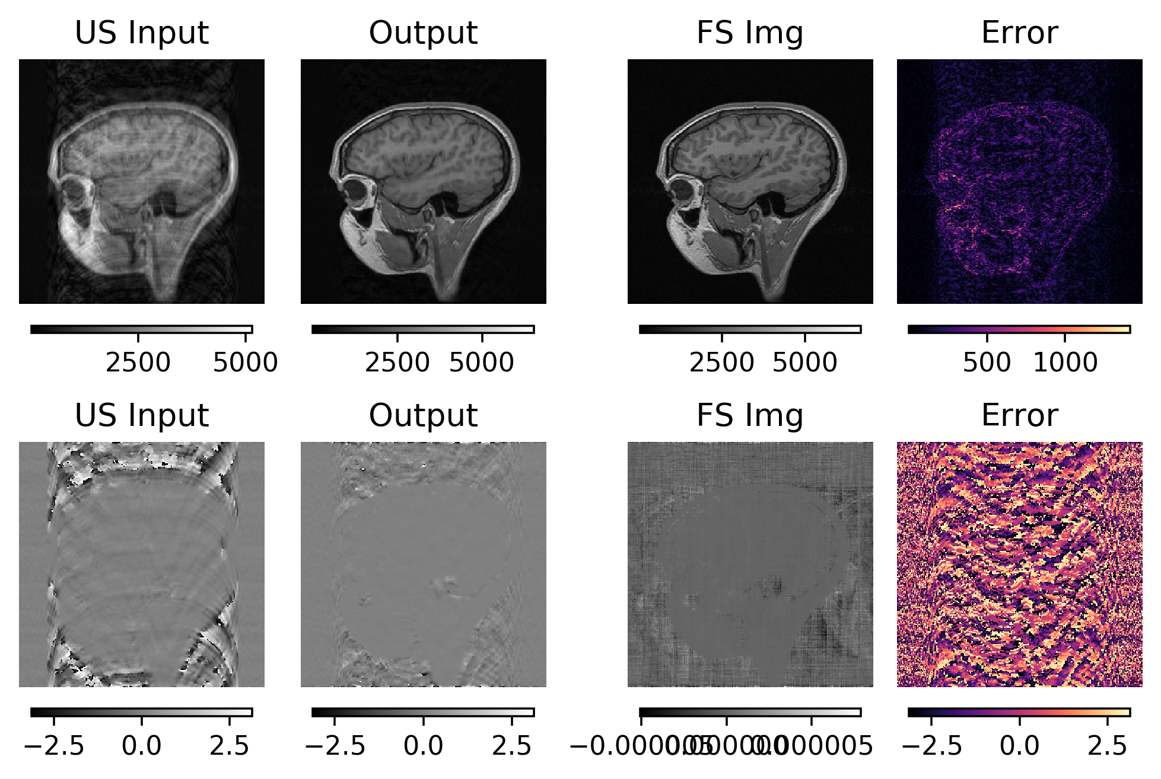
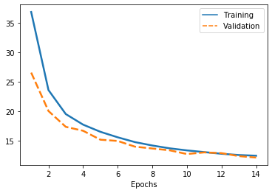
K KI

Slide 20
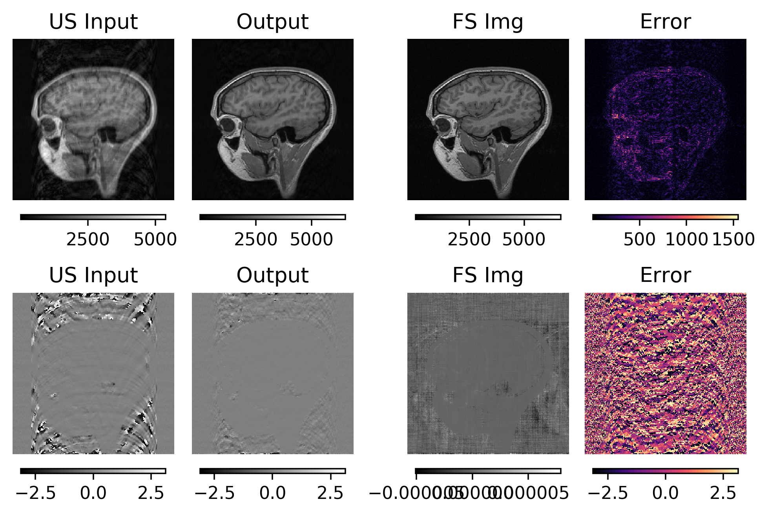
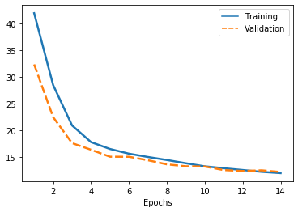
K KIKI

Slide 21
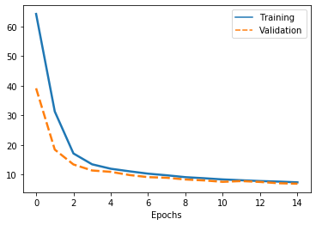

ID 3xIC

Slide 22
Numeric Side by Side Comparisons

Slide 23
Visual Comparison
ID Mag Input
KIKI
3xIC

Slide 24
Conclusions
IC models are much more successful.
KIKI paper indicated that it also used cartesian sampling, however, in that paper IC models have less of a success.
IK might be trained much more to see if it is possible to have a slow training but more succesful model.
IC model can be cascaded and trained to it’s limits.

